Slide 1
Spatial-configuration-based Classification
Majid Farhadloo
CSCI 8980: Spatial Enabled Artificial Intelligence, Spring 2022

Slide 2
Outline
Motivation
Problem Statement
Challenges
Related Work
Contributions

Slide 3
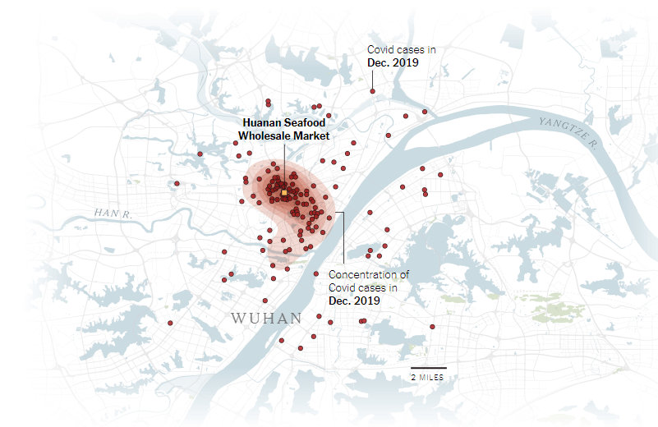
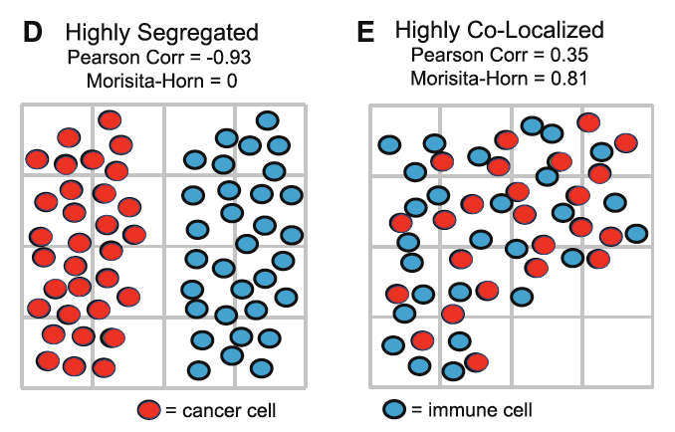
GeoAI for Spatial Pattern Mining
The process of discovering
interesting, useful, non-trivial patterns
from large spatial datasets
Spatial pattern families
Hotspots, Spatial clusters
Spatial outlier, discontinuities
Co-locations, co-occurrences
Location prediction models
…
Hotspot of covid-19 cases at Seafood market in Dec 2019 at Wuhan, China. Source: New Research Points to Wuhan Market as Pandemic Origin, Feb 27, 2022, NYTimes
Source: An ecological measure of immune-cancer colocalization as a prognostic factor for breast cancer. C. Maley et al., Breast Cancer Res 17, 131 (2015).
3
Notes:
GeoAI is a generalization of traditional AI techniques to address uniq
https://www.nytimes.com/interactive/2022/02/26/science/covid-virus-wuhan-origins.htmlue challenges posed by geospatial data
New Research Points to Wuhan Market as Pandemic Origin

Slide 4
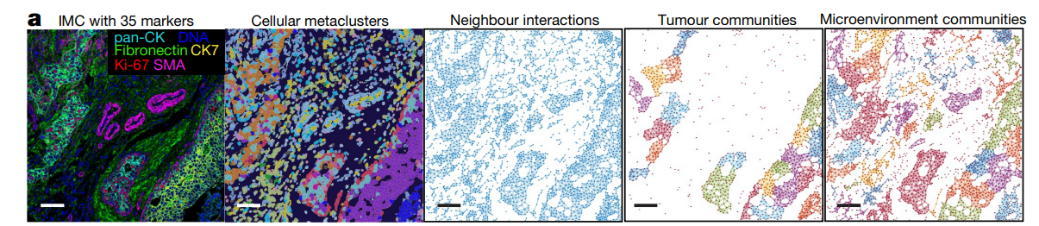
How does GeoAI and spatial analysis tools help?
Crucial to examine intercellular interaction in spatially-informed manner because:
Clinical implications of interactions in close spatial proximity
Evaluate the effectiveness of currently approved FDA blockade
Develop new disease therapeutics (e.g., new immunomodulators such as human leukocyte antigen (HLA I))
Immune checkpoint inhibitors and different functional characteristics of different cells
a CTL is unable to kill a cancer cell if it is nearby a tumor-associated macrophage expressing PDL1 on its surface
“Identify differences in spatial configurations of cells between patients perform poorly vs patient do well on treatment”
Spatial mapping and simple statistics (Naïve and time-intensive approaches):
To understand underlying spatial distribution of immune and tumor cells.
For example, count number of immune cells in spatial neighborhood of tumor cells
Close spatial proximity is a hinit for other spatial approaches:
Spatial Association measures
Participation Index
Cross-K function
4

Slide 5
Outline
Motivation
Problem Statement
Basic Concept
Challenges
Related Work
Contributions

Slide 6
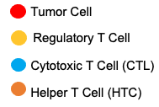
Concept – Spatial-Configuration
Spatial Object:
A representation of a real-world phenomenon related to a specific location or geographical area
Spatial-configuration: Relative arrangement of spatial objects
Spatial-configuration is a fundamental component to measure spatial heterogeneity
The dimension of spatial-configuration analysis may include:
Spatial-graph-based-configuration (This work):
Spatial Co-location,
A subsets of spatial features frequently located together

Slide 7
Concept – Spatial-Configuration
Spatial Object:
A representation of a real-world phenomenon related to a specific location or geographical area
Spatial-configuration: Relative arrangement of spatial objects
Spatial-configuration is a fundamental component to measure spatial heterogeneity
The dimension of spatial-configuration analysis may include:
Spatial-graph-based-configuration (This work):
Spatial Co-location,
A subsets of spatial features frequently located together
Spatial Network Strength
Geometric-based-configuration (others):
Drug discovery, Convex hull analysis

Slide 8
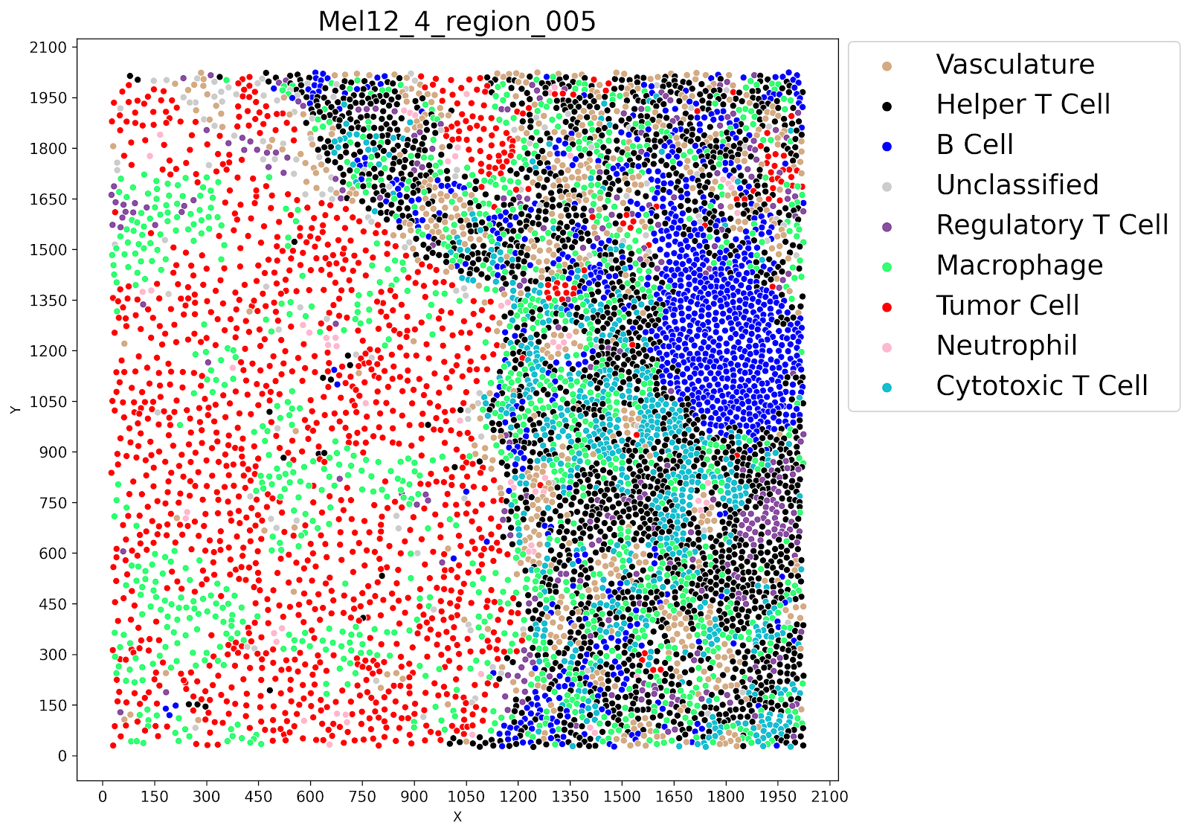
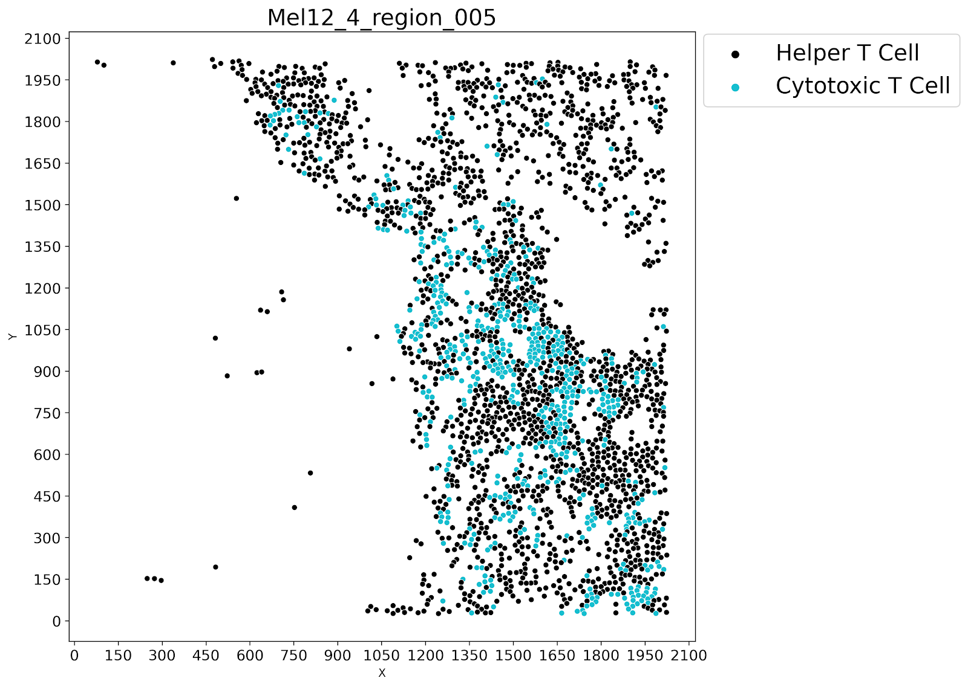
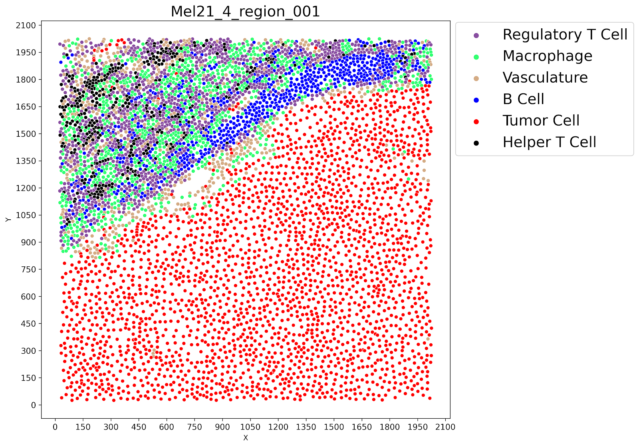
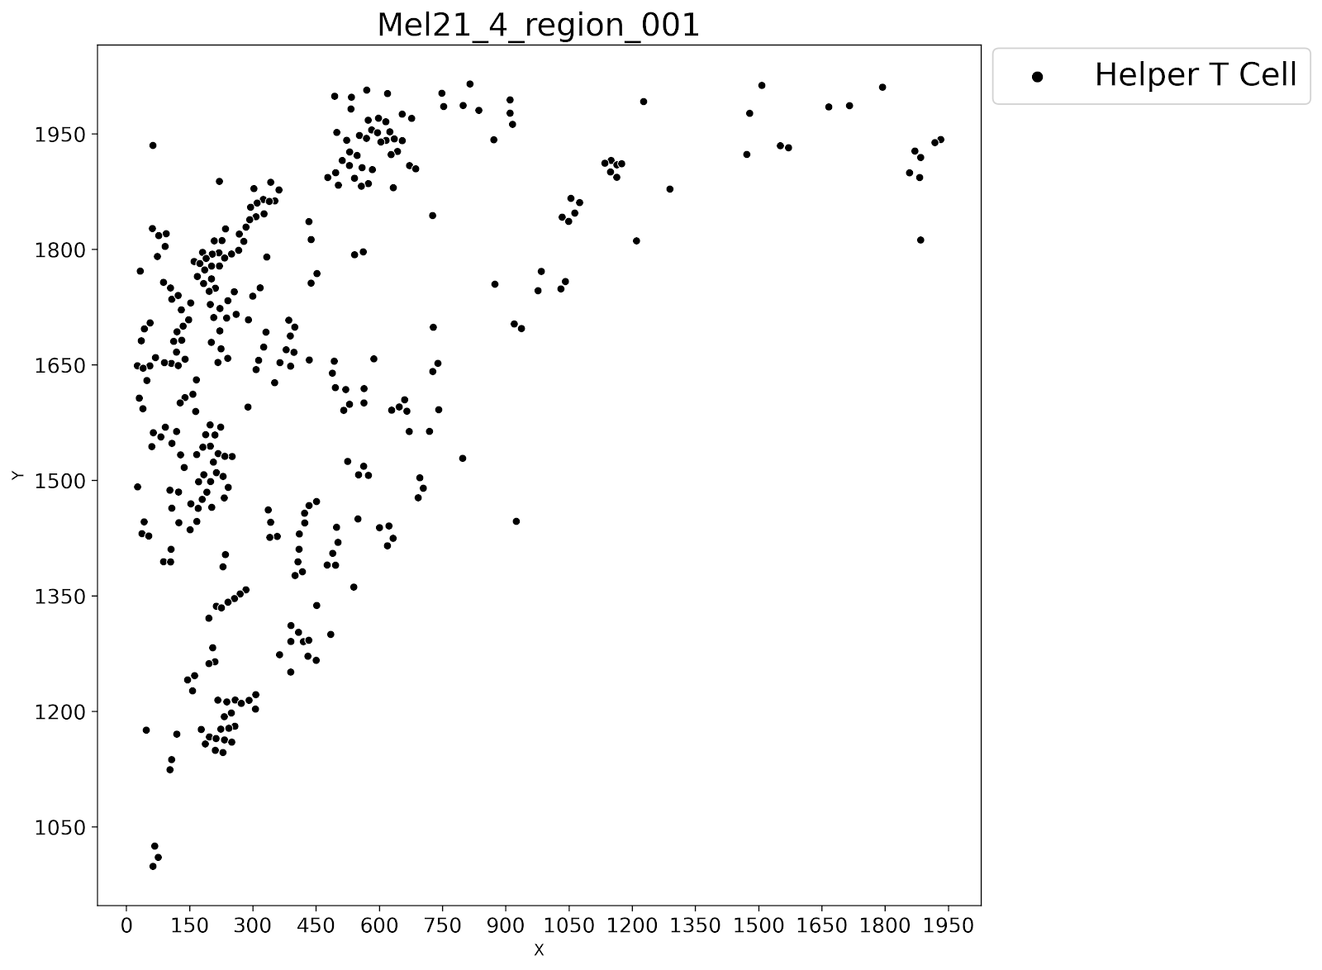
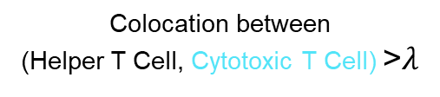
Concept – Spatial-Configuration-Based Classification
Spatial-configuration-based classification:
The process of classifying data into a given number of classes according to spatial arrangement
Example, A decision tree is a supervised machine learning technique that predicts the class label of data objects
a1 . Class 1
Colocation between
(Helper T Cell, Cytotoxic T Cell) >$λ$
False
True
Class 2
Class 1
a2 . Class 2
C. A simple decision tree to distinguish between class 1 and class 2
A. Multi-category point patterns
B. Colocation pair instances between
(Helper T Cell, Cytotoxic T Cell)
9

Slide 9
Outline
Motivation
Problem Statement
Basic Concept
Problem Definition
Challenges
Related Work
Contributions

Slide 10
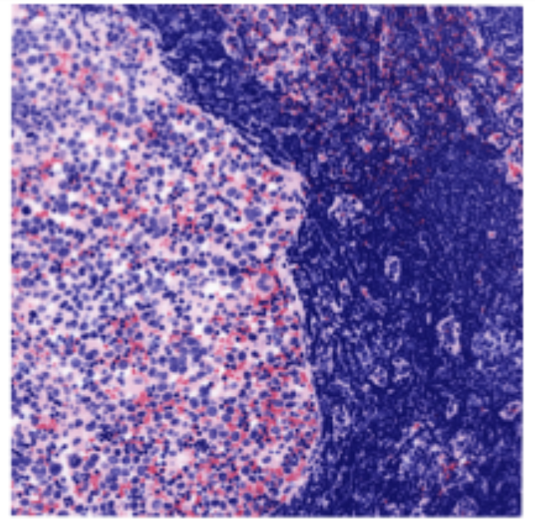

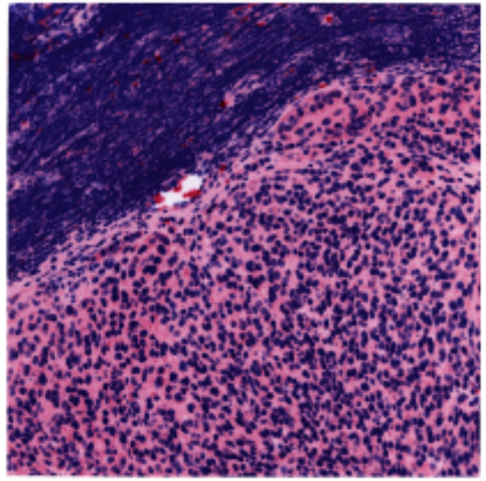
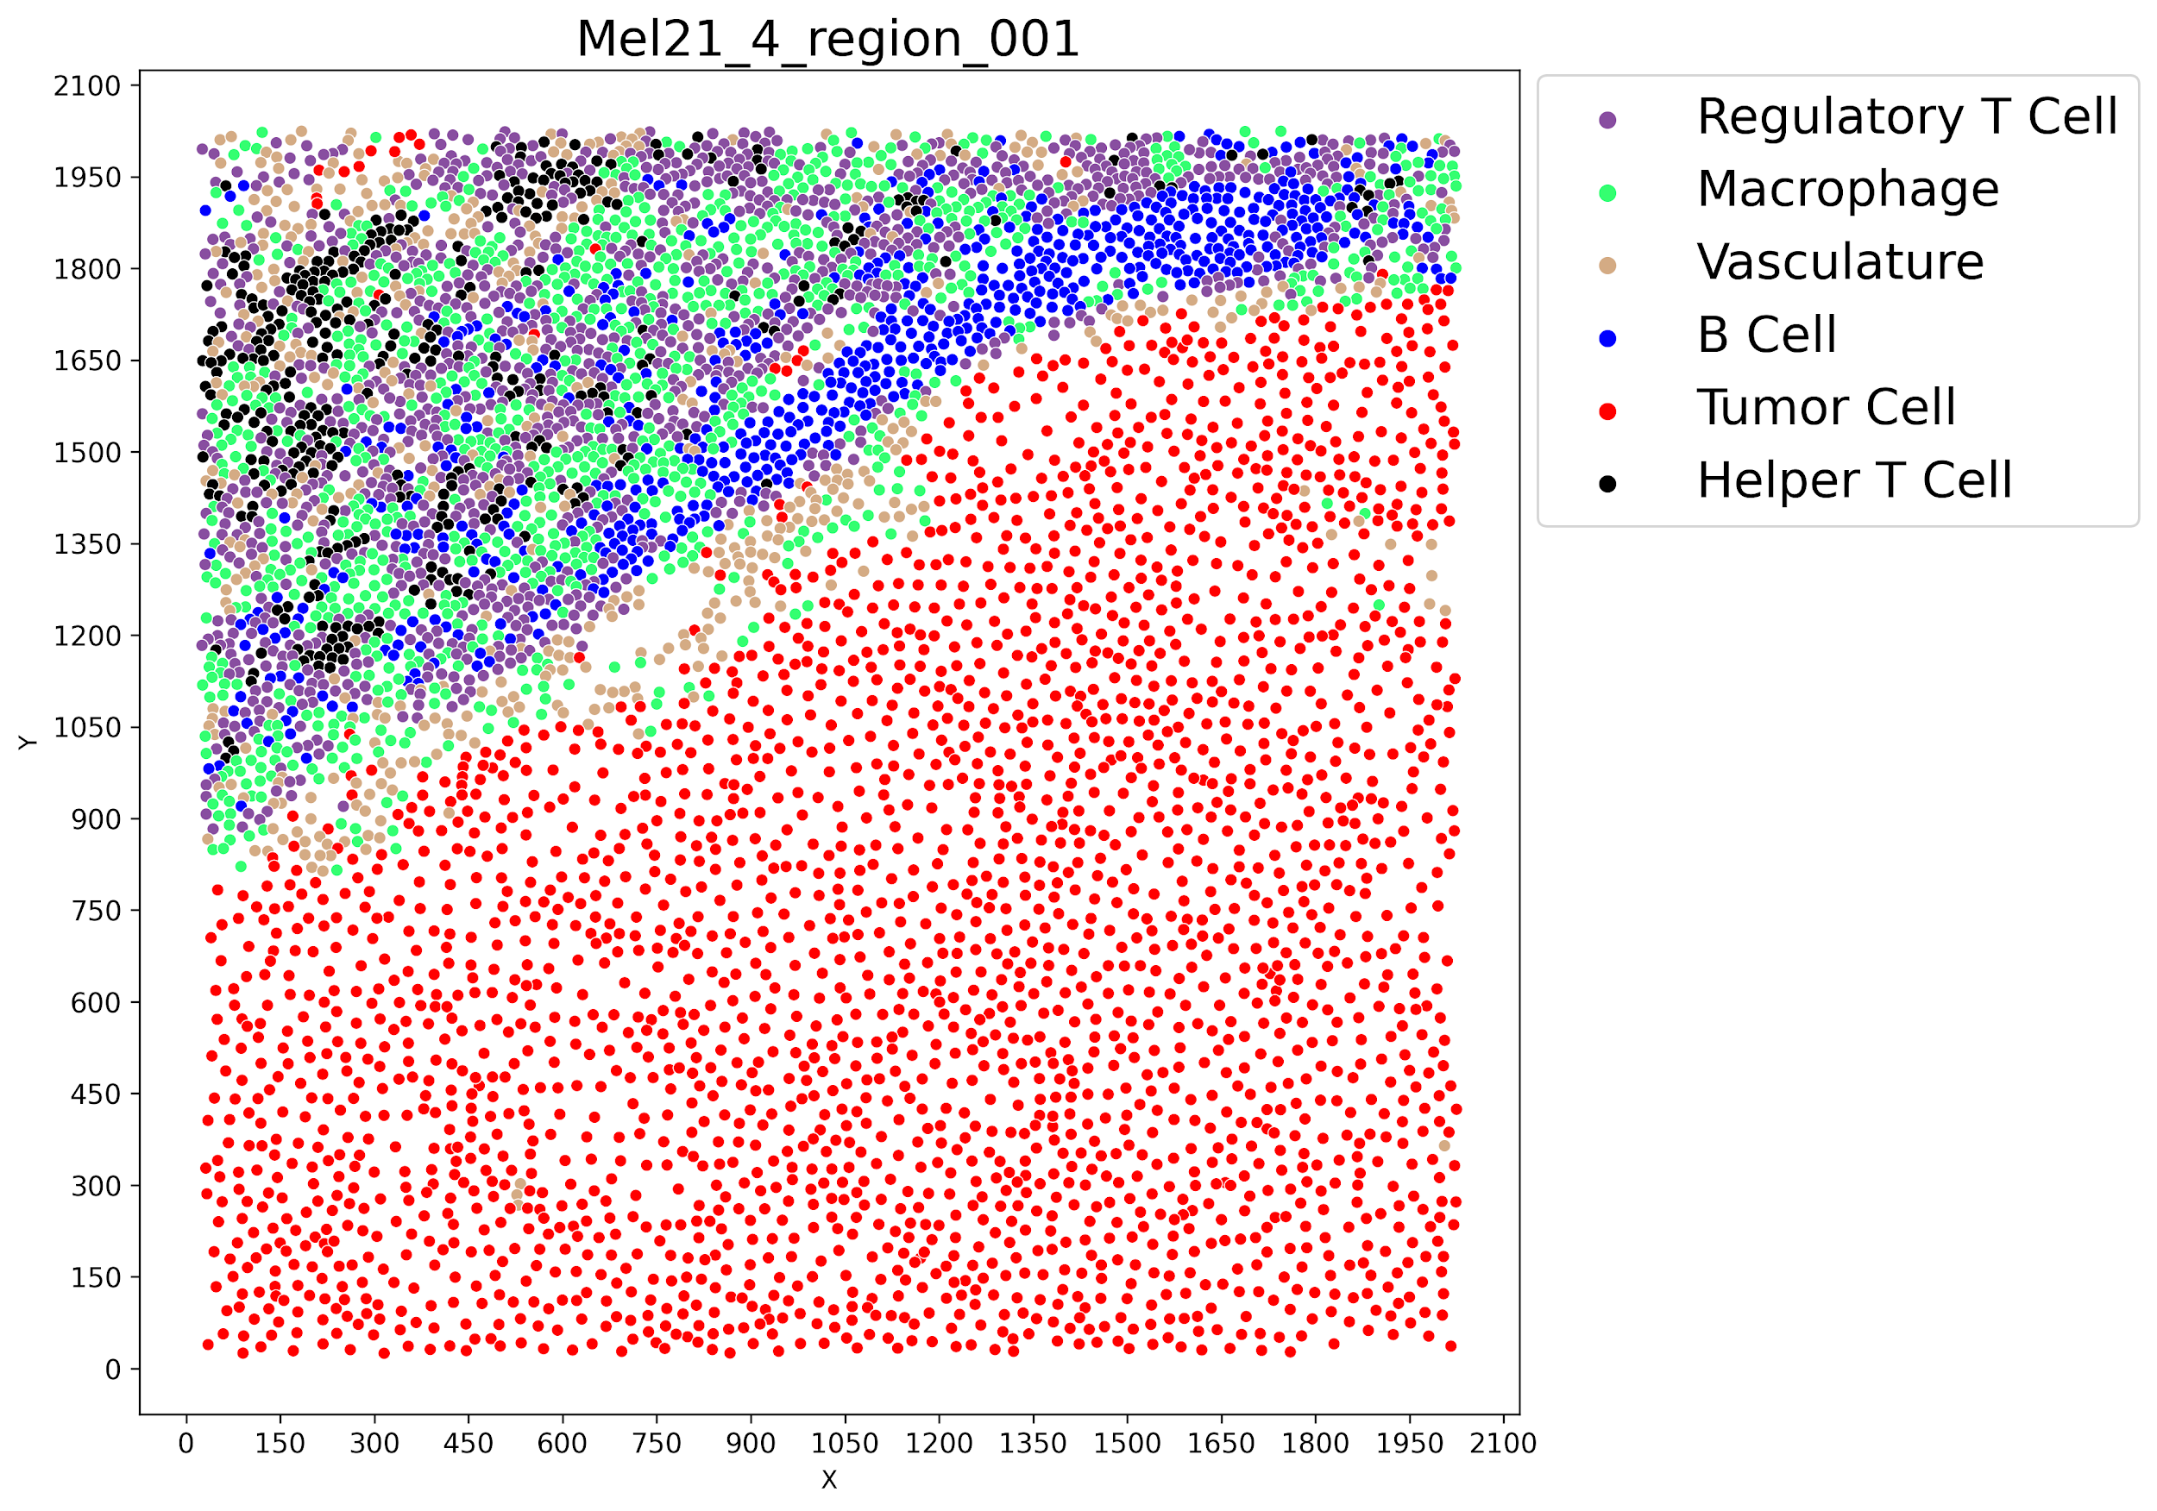
Problem Statement
Input: Given multi-category point data with class labels
Output:
A classifier algorithm separating two classes
Most relevant explanatory features
Objective: Solution quality (e.g., accuracy, precision, recall)
Constraints:
Capable of extracting spatial-configuration-based explanatory features
Working with only two classes which are disjoint
Responder
Non- Responder
11

Slide 11
Outline
Motivation
Problem Statement
Challenges
Related Work
Contributions

Slide 12
Challenges
Spatial distribution varies over space for given points and associated categorical attribute
The strength between different spatial relationship (i.e., point pair instance) is not always equal.
CTL-tumor cell interactions, for example, are more biologically relevant in the context of effector function (e.g., a CTL must engage a tumor cell to kill it); in contrast, B cell-tumor cell interactions are more indirect ^{(Farhood et al 2019)}.
Multi-category point patterns are heterogenous and forming complicated structural and higher-order spatial interactions.
Point patterns possess different properties (e.g., invariance to permutation), which means classifier needs to learn these distinctions.
13

Slide 13
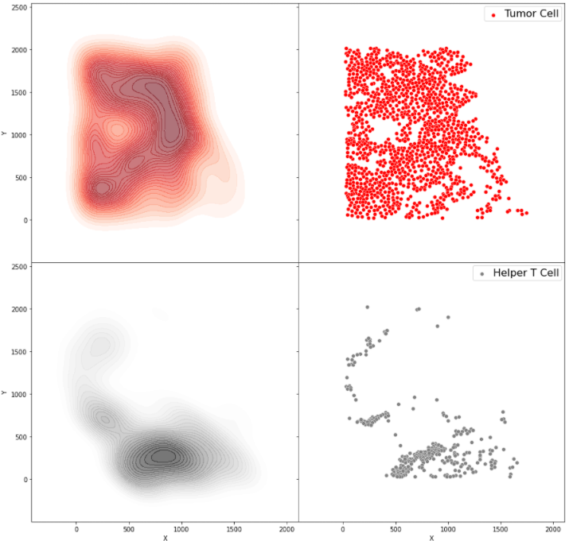
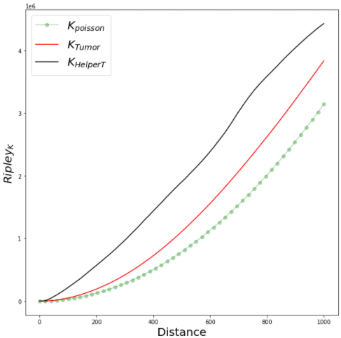
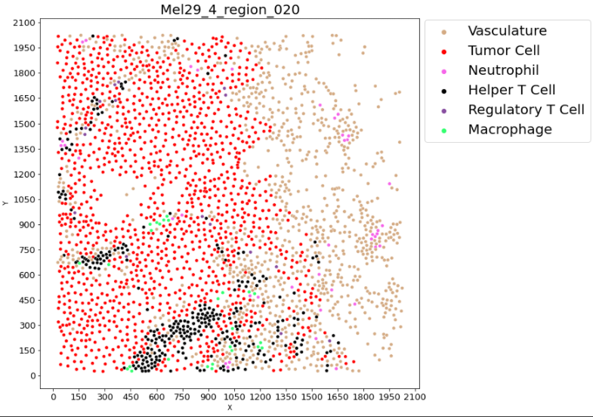
Spatial Distribution Varies Over Space
Input: A point patterns of MxIF data from Tumor-Core region
Analysis: Illustrate the violation of identical distribution
Output: Spatial distribution with different characteristics
Kernel Density Estimation (KDE) of
Helper T Cell , Tumor Cell
Ripley’s K function of
Helper T Cell , Tumor Cell
19

Slide 14
Outline
Motivation
Problem Statement
Challenges
Related Work
Contributions

Slide 15
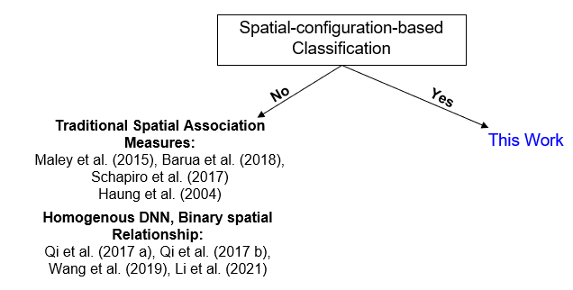
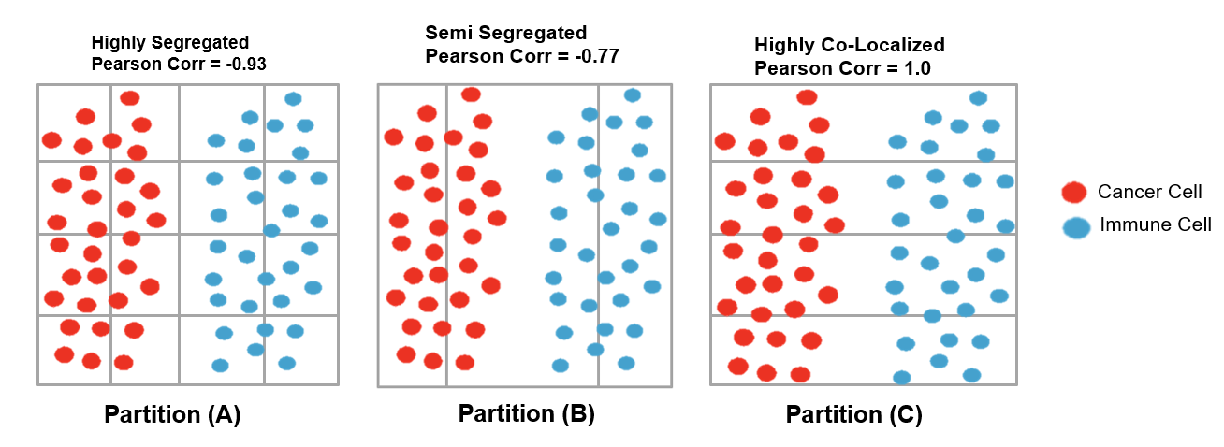
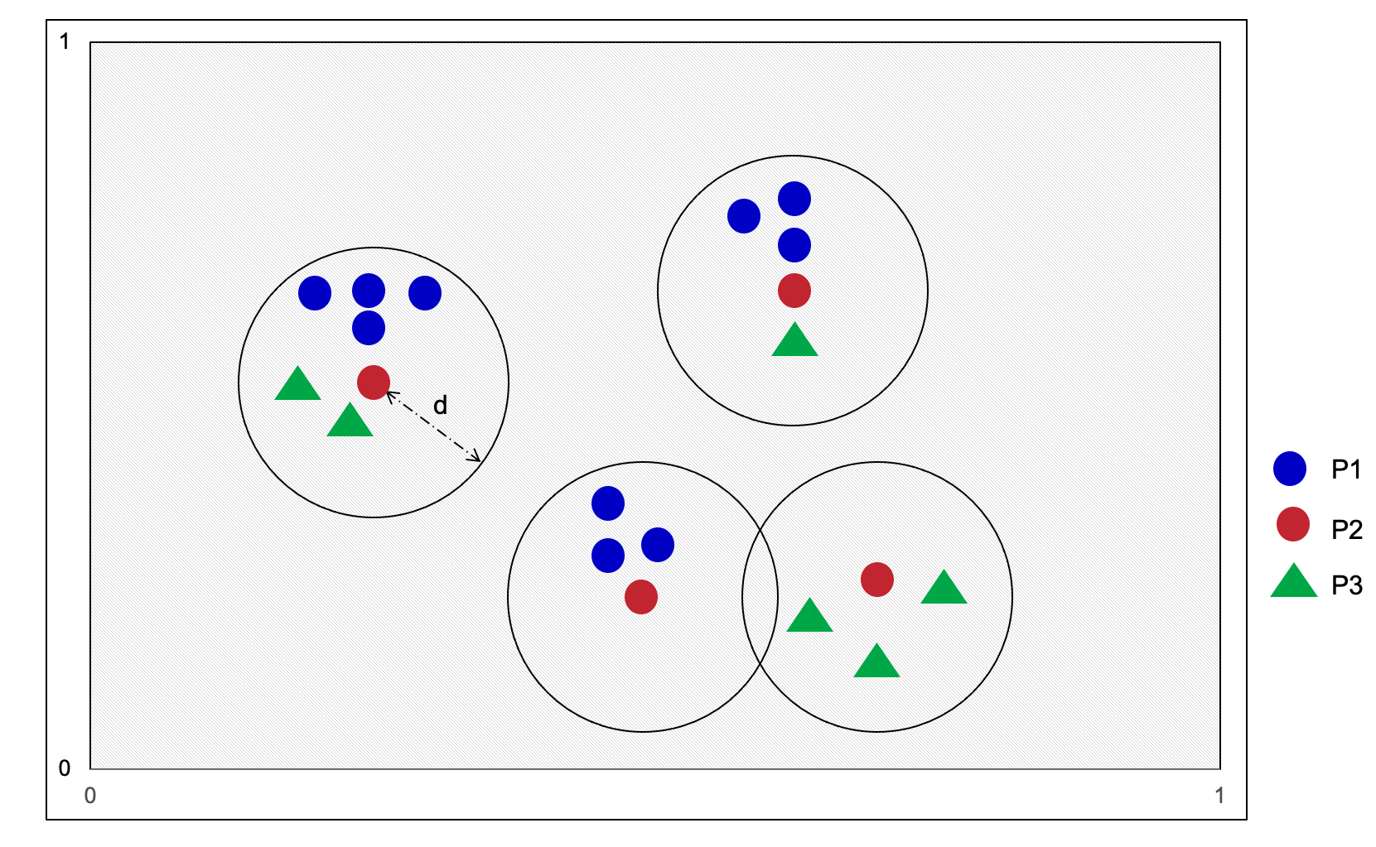
Related works and limitations
Classical data-drive spatial association measures (e.g., Pearson correlation, participation index, cross-k, G-cross, etc.)
Sensitive to space partitioning
May not capture relevant measures (e.g., surrounded by)
Missed spatial interaction at community-level
DNN based techniques
Limited to numerical features and does not benefit from categorical information.
Limited in learning the importance of high-order interactions,
Limited in binary spatial relationships
Assumed the contribution between different category pairs are equal
Comparison of related work with proposed work
15

Slide 16
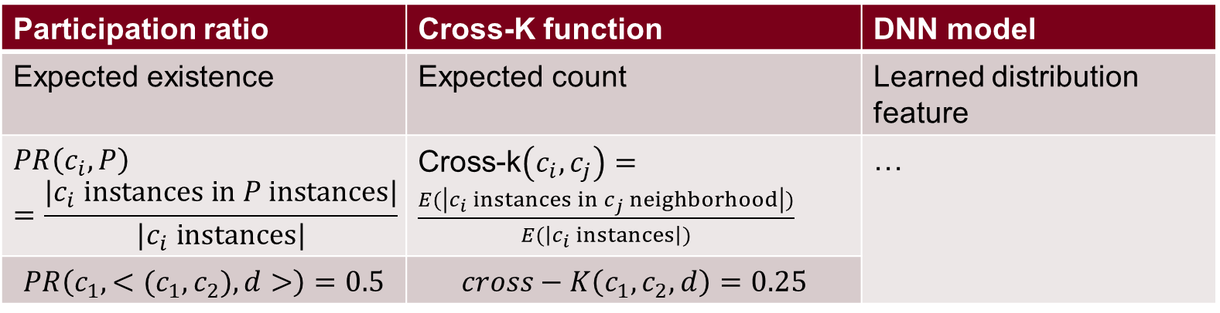
Spatial statistics v.s. DNN Model
Participation ratio | Cross-K function | DNN model
Expected existence | Expected count | Learned distribution feature
$$PR\left(c_{i},P\right)=\frac{|c_{i} instances in P instances|}{|c_{i} instances|}$$ | Cross-k$\left(c_{i},c_{j}\right)=\frac{E(\left|c_{i} instances in c_{j} neighborhood\right|)}{E(\left|c_{i} instances\right|)}$ | …
$$PR\left(c_{1},{<(c_{1},c}_{2}),d>\right)=0.5$$ | $$cross−K\left(c_{1},c_{2},d\right)=0.25$$ | …

Slide 17
Outline
Motivation
Problem Statement
Challenges
Related Work
Contributions

Slide 18
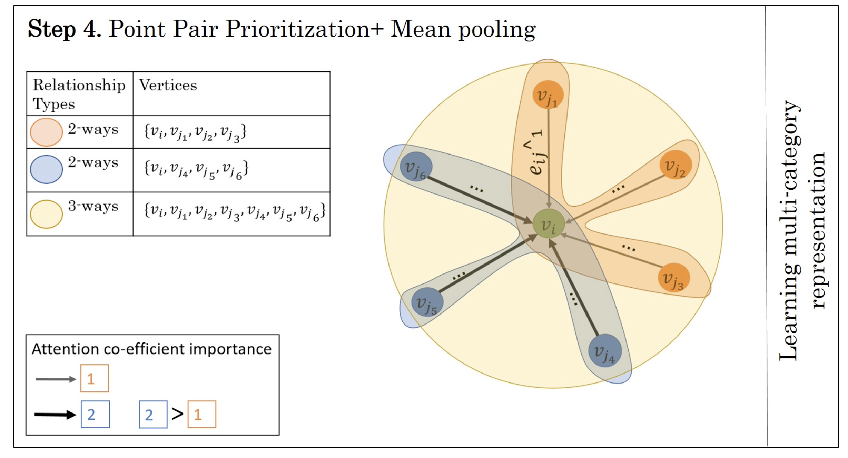
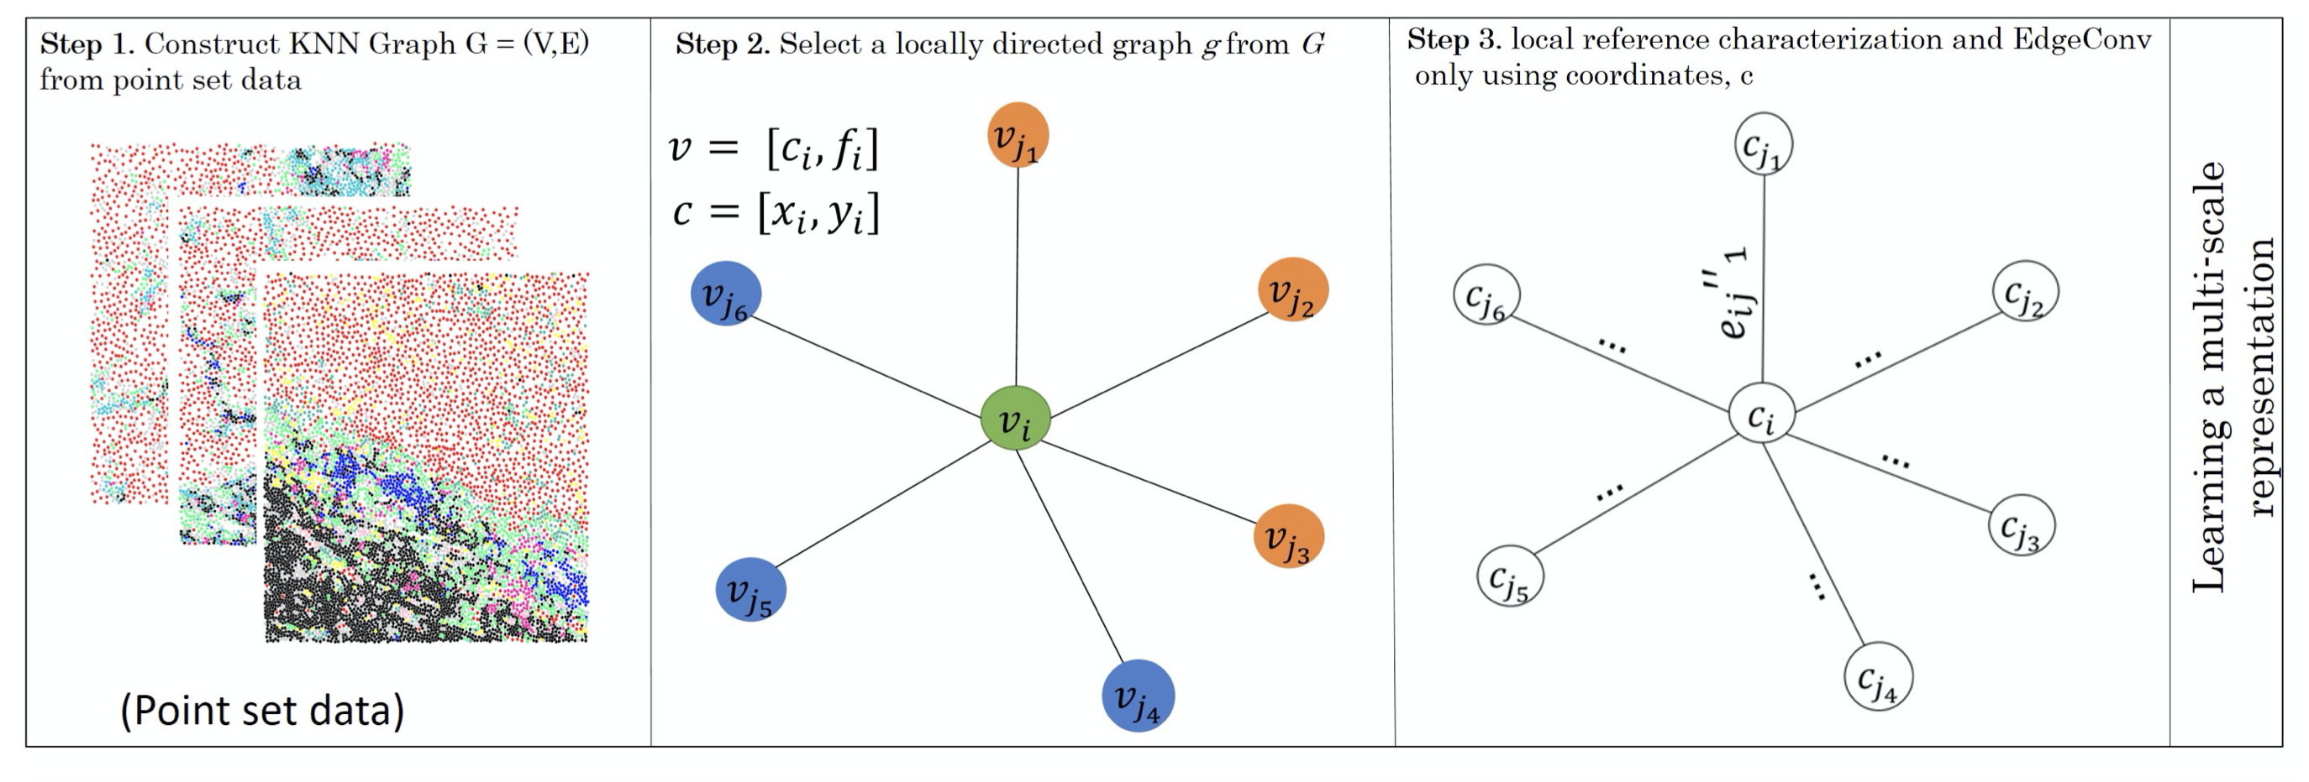
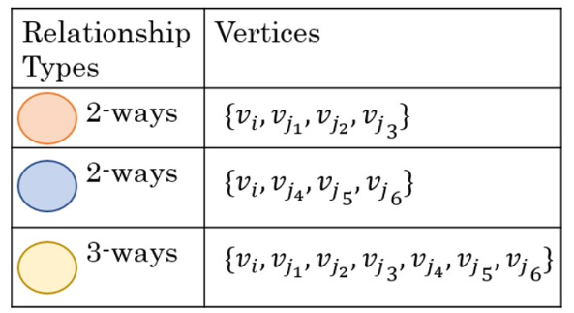
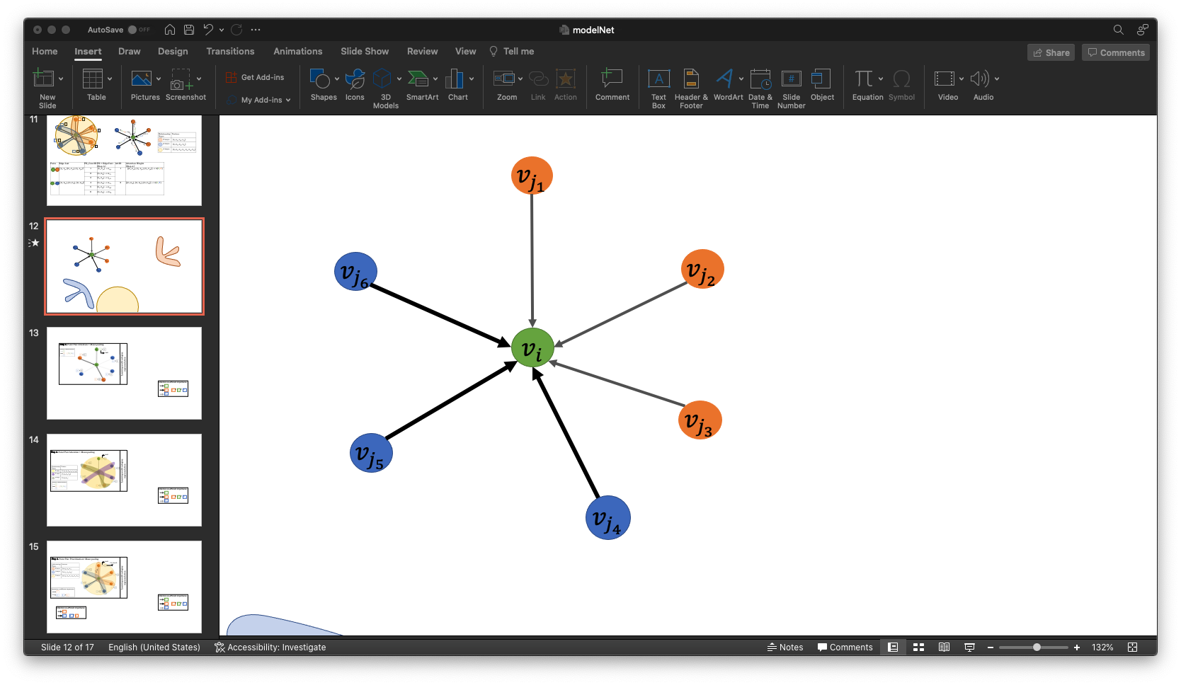
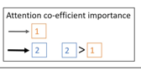
Spatial-interaction Aware Multi-Category Deep Neural Network (SAMCNet)
To overcomes these limitations, we design a new neural network architecture, namely SAMCNet, contributing:
Local Reference Frame Characterization
A better way to represent local information using a multi-scale position embedding and spatial feature decomposition before quantifying local information.
Prioritization Sub-Network
Learning the importance of different multi-categorical relationships, especially for high-order interactions.
16

Slide 19
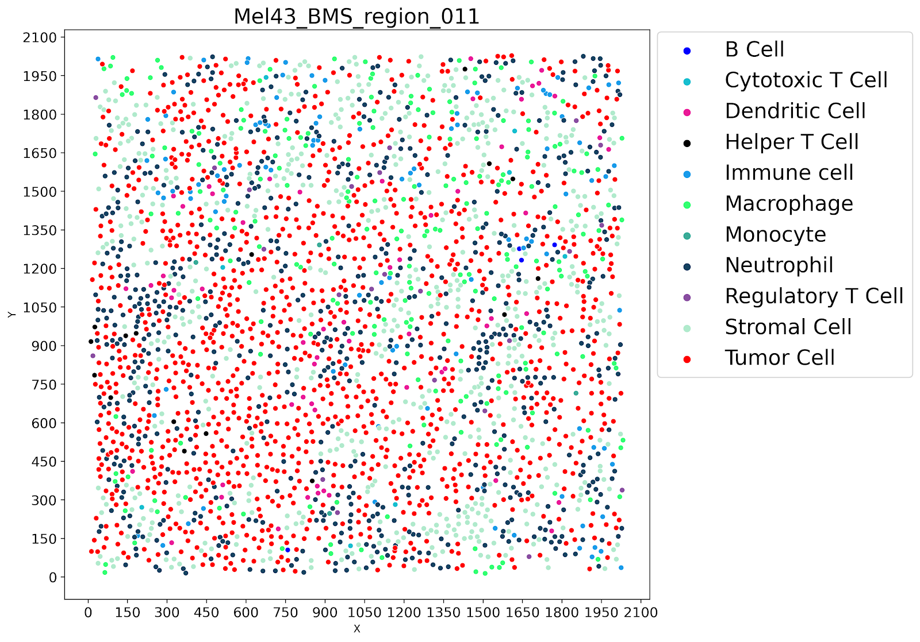
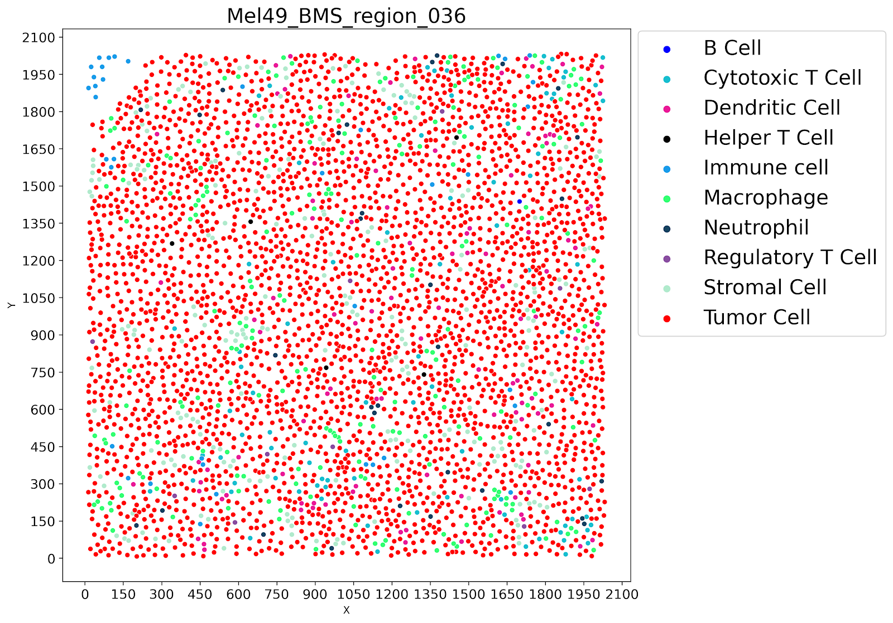
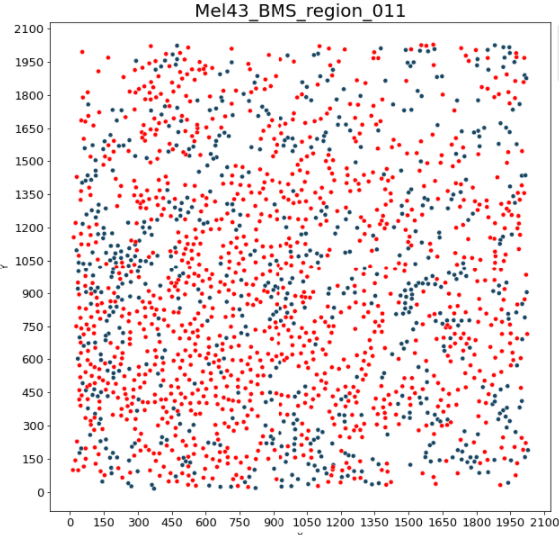
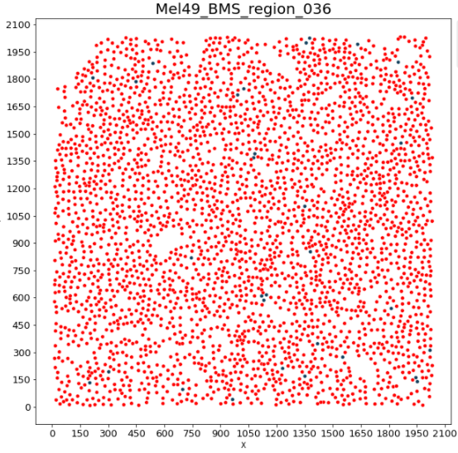
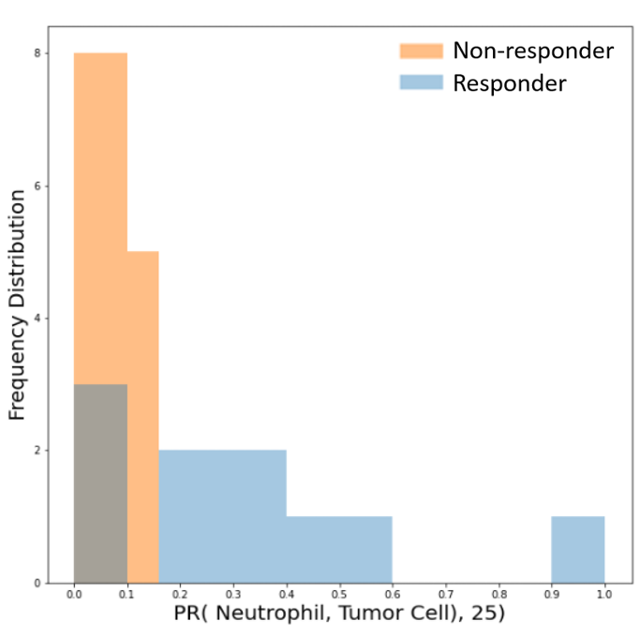
Hand-Constructed Spatial Features are Promising (Decision-Tree Classification Accuracy ~ 71%)
a. MxIF pointset detailing all cell classes)
b. co-location instances between Neutrophil and Tumor Cell
PR(Neutrophil, Tumor Cell), 25) <= 0.16
False
d. Frequency distribution of participation ratio “PR ((Neutrophil, Tumor Cell), distance = 25)” with the dashed black line for 0.16 threshold
True
[0 Recurrence,
9 No Recurrence]
[13 Recurrence,
3 No Recurrence]
c. A simple decision tree to distinguish between responder and non-responder in the tumor-margin (learned from 25 training FOVs

